Slide 1


Rust, a C/C++ Replacement?
James R. Small, Principal Architect

Slide 2
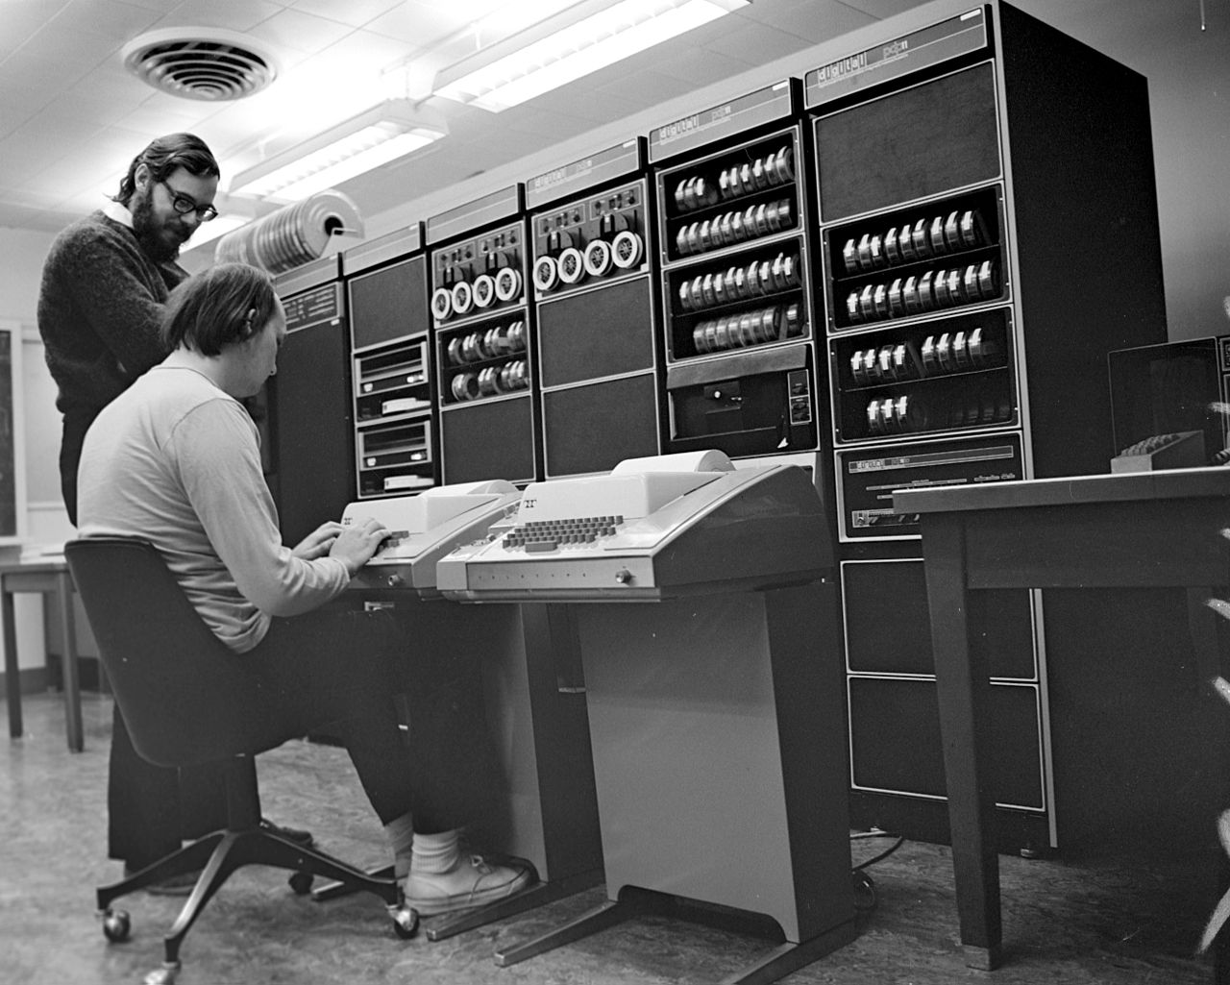
Dennis Ritchie and Ken Thompson – Inventors of C and UNIX
C evolved from the B Programming Language (1971)
First graphics terminals (1972)
First Intel x86 CPU (8080 – 1974)
Migration of Internet to TCP/IP (1983)
Unicode (modern language/ symbol representation – 1987)
First widespread security incident (Morris worm – 1988)
Image Source: Wikipedia
Notes:
Dennis Ritchie and Ken Thompson – Pioneers of modern technology
In the 1960s, Bell Labs was collaborating with MIT and General Electric on Multics – a next-generation time-sharing operating system
Dissatisfied with the progress, Bell Labs pulled out in 1969
One of the project participants, Ken Thompson, really liked the hierarchical file system and the shell ideas from Multics though
He implemented his own file system on a spare PDP-7, but decided he really needed to test it
So he did what any good engineer would, he wrote what became UNIX to test his file system
At the same time, Thompson developed the B programming language based off the BCPL language he used in the Multics project
Thompson’s coworker, Dennis Ritchie also worked on developing B
Ritchie liked B, but when they migrated it from a PDP-7 to a PDP-11 several deficiencies became apparent
As a side note, in today’s terms these computers cost over $500,000 and filled a room
The first popular Personal Computer, the Altair 8800, wouldn’t be released until 1975
One of the biggest one was that B was typeless and Ritchie determined that a typing scheme was necessary
He began incorporating this into B and New B evolved into C
It is worth noting the environment that Thompson and Ritchie worked in
A PDP-7 had a single 18-bit CPU/core with up to 144kb of RAM – a completely different architecture than today
External storage consisted of a tape drive – hard drives weren’t yet that popular
A printer served as a display – you’ll note no monitor in the picture
Computers were stand alone – the first Ethernet networking standard wouldn’t emerge until 1980
Security wasn’t a consideration
In addition, per Ritchie none of BCPL, B, and C have strong character data support – rather characters are special cases of integers with strings being vectors of integers
Furthermore, while BCPL included a character count at the beginning of a string, B choose to remove this and instead use a special termination character
C retained this design which in hind sight was an unfortunate choice with many painful security consequences

Slide 3

Bjarne Stroustrup – Inventor of C++
C with classes (later renamed C++) evolved from C (1979)
Stroustrup wanted the Simula programming language class features and C’s efficiency
A key decision was to build on C (maintain compatibility)
A big part of C++’s success
C essentially portable assembler with near ubiquitous platform support
Unfortunately also major weakness for C++, shackled with C’s weaknesses
Image Source: Wikipedia

Slide 4
What This Talk Is Not
Not about disparaging C
To me, Dennis Ritchie is an inspiration
He took what he had and made it better
Not about denigrating C++
Dr. Stroustrup combined some of the best languages at the time
Much of want he wanted to do wasn’t possible at the time
Notes:
We’re learned a lot about programming languages and type systems in the intervening decades
That’s why there are a bunch of relatively new popular programming languages including Swift, Go, and Rust among others
However, this will be a frank discussion of some of the weaknesses of C and C++ so if you’re a fan, brace yourself!

Slide 5
Using The Right Tool…
When you need a Systems Programming Language – what is the best choice?
No language is perfect – which tradeoffs you want to make?
I hope to convince you that Rust is a strong contender for your time
Using Rust will make you a better programmer – even if you primarily use another language!
Image Source: x
Notes:
This talk is designed to challenge your assumptions and make you think!
Also note that many in the C++ community think it takes 3 – 5 years of professionally using C++ to really learn it
So I can show you the basics of the language and hopefully make you curious, but I can’t teach you Rust in 75 minutes!

Slide 6

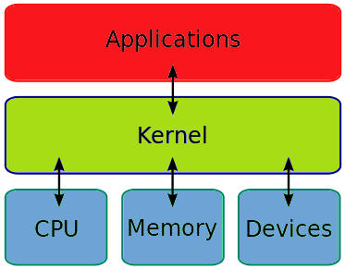

Why C?
Proven – Used everywhere for nearly 50 years
Performant – Fast, Efficient, Minimal runtime
Portable – often referred to as “portable assembler”
Ubiquitous – compilers for virtually any platform
Simplicity – relatively small language
Existing Code Base – easiest interface option
Stable Specification - standardized, little change
Image Sources: https://www.online-sciences.com/programming/c-programming-language-features-advantages-and-disadvantages/, Wikipedia, https://www.udemy.com/course/embedded-c-programming-for-embedded-systems/
Notes:
Although many refer to C as “portable assembler”, this is a contentious claim
C was developed alongside UNIX
C was created to be efficient and performant enough to use instead of assembler
UNIX was ported from assembly to C
As UNIX was ported to a variety of other platforms in addition to the original PDP architecture, C and the C standard libraries were a key tool
C is both the dominant embedded and operating system programming language
While higher level operating system components – especially graphics typically use C++, the kernel and lower levels are virtually all C, even in Windows

Slide 7



Why C++?
Proven – Extensive use for over 40 years
Performant, Portable, Ubiquitous – C-like
Existing Code Base – easiest interface option
Better Abstractions – classes and OOP
Generics – data structures/algorithms (STL)
Functional features – template metaprogramming, lambdas
Zero-Overhead Principle – don’t pay for what you don’t use
Image Sources: Wikipedia, https://devblogs.nvidia.com/separate-compilation-linking-cuda-device-code/
Notes:
C++ tries to tighten up C’s type system
It does offer some improvements
However, to maintain backwards compatibility, it still has most of C’s weaknesses
C++ is used extensively in graphics and graphics subsystems
This includes the most popular cross-platform framework – Qt
It also includes WxWidgets and Microsoft’s MFC and WTL frameworks
However there are some notable exceptions such as GTK which is written in C

Slide 8


What’s missing from C/C++ versus Modern Programming Languages?
Ecosystem Problems:
No standard build system
No standard dependency management system
No standard packaging format or system
No standard/centralized package registry
No reference compiler implementation
Standard language definition with various implementations – MSVC, GCC, Clang, …
Image Sources: The Blazing Center, Inhabitat
Notes:
The lack of a standard build and packaging tools along with no central registry causes many systemic issues for the C and C++ communities
Sharing programs and libraries is a challenge
Because of this, many wheels are continuously reinvented
Collaboration is challenging and the community is fragmented
The standard example or joke about this for C/C++ is JSON
Whereas all modern languages have a library which implements JSON serialization/deserialization, C/C++ don’t
Instead, you will find dozens of options with no standard
Because there is no standard build/packaging system each one takes different approaches
So things which are trivial in other languages actually become a project in C/C++
Even Herb Sutter, the C++ ISO WG Chairman will joke about this
There are many build systems and packaging systems to choose from but no standard one
These will include collections of popular “packages” which number in the 100s to 1000s
However, modern languages have package registries in the 100s of thousands to over a million
Furthermore, the lack of a reference implementation exacerbates the problems and makes its extremely difficult to come up with standards
Instead, each vendor/implementer has their own ideas and goals which are often incompatible

Slide 9


Issues with C/C++ versus Modern Programming Languages?
Language Problems:
Undefined Behavior everywhere – creating robust and secure programs extremely difficult
C has no native concept of a String
C++ has a String, but backwards compatible with C
Essentially an array of 8-bit integers designed for ASCII
Weakly typed, endless source of security issues
Doesn’t natively support Unicode
Null terminated (i.e., uses in-band ASCII character)*
Image Sources: Quick Country 96.5, Fiore Group Training
Notes:
C-strings are null terminated
In addition to the use of an “in-band” character and security issues, this is also a performance problem
Determining the length of a string requires scanning for the null character
O(n) operation instead of O(1) when length is part of a string type
C++ std::string knows its length, but there are still many places where C-strings are required
*Source of confusion and security issues
Because strings must add a null termination character, the length of a string must account for this
In addition, using a special character which is part of the standard character set results in issues, limitations, and vulnerabilities
**Most programming languages keep track of the length of a string
This provides better performance because you know how long the string is rather than having to parse it
This provides better security as there are no off-by-one errors or worrying about interpreting special characters incorrectly
Ironically, the predecessor to C, BCPL, did use string lengths and not a termination character – this was an unfortunate design choice

Slide 10
Issues with C/C++ versus Modern Programming Languages?
Language Problems (continued):
Built-in arrays problematic
Decay to pointer when passed
Don’t know their own size
Don’t really support multi-dimensioning
C++ Templates also problematic
Didn’t include early type checking in their design (per Stroustrup this wasn’t possible at the time)
Macros are a separate system which don’t understand the language
Image Sources: Quick Country 96.5, Fiore Group Training
Notes:
Why a problem?
Arrays not convenient to pass around
Source of security issues
Templates are challenging to keep type safe
The diagnostics are awful and difficult to understand/troubleshoot
Since macros don’t understand the language they can cause problems/bugs

Slide 11


Why not C/C++?
Lack of Memory Safety
Use after free (dangling pointer access)
Double free/Invalid free
Use of uninitialized memory
Buffer overflow* (overreads/overwrites)
Out-of-bounds access (access past end of array)
Null pointer access (Dereferencing)
Memory leaks (stack/heap exhaustion)
Data races (concurrent mutable access)
Image Sources: safetysignsupplies.co.uk, https://www.fool.com/retirement/general/2015/01/13/the-time-bomb-lurking-in-your-social-security.aspx
Notes:
*Source of many (most?) security issues
See also: https://en.wikipedia.org/wiki/Memory_safety

Slide 12

Why does memory safety matter?
"The majority of vulnerabilities fixed and with a CVE assigned are caused by developers inadvertently inserting memory corruption bugs into their C and C++ code.”
“As Microsoft increases its code base and uses more Open Source Software in its code, this problem isn't getting better, it's getting worse."
- Gavin Thomas, principal security engineering manager at the Microsoft Security Response Center (MSRC)
Image Source: https://msrc-blog.microsoft.com/2019/07/16/a-proactive-approach-to-more-secure-code/
Notes:
Can’t we just use better tools like static analyzers/sanitizers, and safe coding guidelines?
According to Microsoft, this isn’t helping
An interesting question is this:
Is the job of a software developer to focus on mastering incredibly difficult security problems?
Or is it to focus on producing applications that users value?

Slide 13
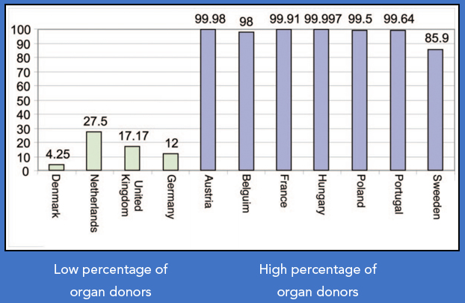
Thoughts on turning Systems Programmers into Security Experts
Listening to security experts – things have not improved, the same mistakes are repeatedly made
Perhaps a better solution is security by default
Image Source: https://jamesclear.com/environment-design-organ-donation
Notes:
I wasn’t able to find a definitive study of the impact of better tooling and secure coding practices
However, the general consensus seems to be that it’s not enough
Sometimes it can help to look at different disciplines for ideas
In terms of solving critical issues, on average 20 people per day die waiting for an organ transplant
Looking across countries, why do some have near universal participation in organ donation and yet others struggle to find enough?
It turns out it’s a policy issue.
Countries with high donor rates have an opt-out policy
Countries with low donor rates have an opt-in policy

Slide 14
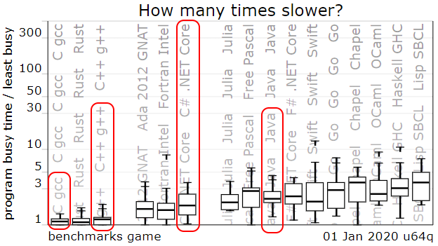
Just Use Memory Safe Languages?
Languages like C# and Java can work well in many contexts, but not all.
Microsoft tried to rewrite the Windows shell, making extensive use of C# and Windows Presentation Foundation, for the first attempt at Windows Vista.
The result was impossibly slow and the company made a famous "reset" back towards native code in 2004.
As shown to the left, C# and Java tend to be about twice as slow compared to C/C++
The Computer Language Benchmarks Game
Image Source: https://benchmarksgame-team.pages.debian.net/benchmarksgame/which-programs-are-fastest.html
Notes:
Traditional memory safe languages like C#, Java, Python, JavaScript, and PHP work well in many contexts
However, when raw computational speed and efficiency are most important, systems programming languages tend to be faster
While benchmarks are never perfect, in general C/C++ outperform memory safe languages
There is one interesting new entry – Rust
It has performance on par with C/C++ and we'

Slide 15

Thoughts on C++
“C++ is a great language as long as you don’t make any mistakes
– no pressure!”
"Rather than investing in more and more tools and training and vulnerability fixes, what about a development language where they can't introduce memory safety issues into their feature work in the first place?" - Microsoft Security Response Center
"If only developers could have all the memory security guarantees of languages like .NET C# combined with all the efficiencies of C++. Maybe we can with Rust." - Microsoft Security Response Center
Image Source: https://luckybjj.com/should-i-lose-weight-before-starting-jiu-jitsu/person-thinking-png-hd-thinking-man-png-png-person-thinking-1169/
Notes:
Mozilla engineers such as Jim Blandy describe that when you program in C++ it’s stressful because if you aren’t perfect, millions of people will get owned by your mistake.
That’s because Firefox is still developed primarily in C++

Slide 16

Developing in C/C++
Standard joke about C/C++ from programmers in other languages:
Segmentation fault (core dumped) – good luck
When a program crashes:
No stack trace
No guarantee of memory integrity
Often you have little idea where the problem is
Assumption is you have excellent tooling and superb debugging skills
Image Source: https://www.ministrymatters.com/all/entry/4068/7-of-the-most-frustrating-things-pastors-experience

Slide 17

Assumptions about Performance Critical Code
Must be native (compiled into machine code)
Cannot use a Garbage Collector (GC) – results in non-deterministic performance when GC runs
Must use manual memory management – consequence of no GC
Rules out most programming languages besides C/C++
There are languages like D, but they have not become mainstream
Image Source: ul.com

Slide 18
Current Programming Language Landscape
Language | TIOBE | PYPL | RedMonk | StackOverflow | SlashData | IEEE
C | 2 | 6 | 9 | 11 {D-4} | 5 | 3
C++ | 4 | 6 | 5 | 10 {D-9} | 5 | 4
Java | 1 | 2 | 2 | 5 {D-10} | 3 | 2
PHP | 8 | 5 | 4 | 8 {D-5} | 6 | 13
JavaScript | 7 | 3 | 1 | 1 {-*} | 1 | 6
C# | 5 | 4 | 5 | 7 {L-10} | 4 | 7
Python | 3 | 1 | 3 | 4 {L-2} | 2 | 1
Swift | 9 | 9 | 11 | 14 {L-6} | 8 | 9
Rust | 30 | 18 | 21 | 21 {L-1} | - | 17
D | 17 | - | Low | - | - | 42
Ada | 38 | 23 | - | - | - | 43
Notes:
This is a list of the 8 most prominent/popular general programming languages plus three extra ones in blue at the bottom
I’m using six of the most popular sources for ranking programming languages
Note – For StackOverflow, L = Most Loved rank, D = Most Dreaded rank
JavaScript is over 10 for both loved and dreaded, but slightly more loved
I don’t include VB.Net in the programming language list.
C# is the Microsoft .Net language targeted at developers
VB is focused more on non-traditional developers
The first 7 languages are clearly dominant players.
Swift is debatable depending on which source you consider
However, from consulting half a dozen sources, Swift was in the top more than any other alternative such as Ruby or Go
I also excluded non-traditional programming languages and DSLs like HTML, CSS, SQL, and SQL Dialects

Slide 19
Current Programming Language Landscape
Systems Programming Languages | Comments
Ada | Fading away
C | Dominant embedded language
C++ | Along with C, dominates systems category
D | Niche language
Rust | Mozilla’s up and coming systems language – the most loved language 4 years running (StackOverflow)
Swift | Apple’s systems language – gaining in popularity (replacing Objective-C)
Notes:
Note that Go is not in the systems programming list – Wikipedia doesn’t include it and I don’t either.
I classify a systems programming language as one you’d write an operating system kernel with.
That definition excludes Go which uses a Garbage Collector for automatic memory management.
Writing a kernel requires tight control over memory allocation and deallocation.
That’s not to say Go isn’t a great programming language, just that it’s choice to use GC excludes it from this category.

Slide 20



Graydon Hoare – Inventor of Rust
Started as side project in 2006
Frustrated with C++ complexity, lack of safety
Wanted C-like performance/efficiency with safety and strong concurrency support
Mozilla picked up in 2009, announced in 2010
1.0 released in May 15, 2015 with stability commitment (currently 1.40)
6 week cadence with 3 channels – nightly, beta, stable
Major changes done through Editions (2015, 2018, …)
Image Sources: Mozilla, https://adainitiative.org/2012/10/13/graydon-hoare-i-donated-because-id-like-to-see-the-culture-change/, Lars Bergstrom
Notes:
See: https://github.com/graydon/rust-prehistory
It’s worth noting that the C++ community really likes the concept of editions and is considering its adoption

Slide 21

Enter Rust
Native binaries
Automatic memory management without GC
Memory safety
Fearless concurrency
C-like performance/efficiency
Much easier to troubleshoot
Friendly compiler diagnostics
Stack traces on by default
No Undefined Behavior!
No Segmentation Faults!
Image Source: Celebrations Magazine
Notes:
Rust has a provably correct type system which is much stronger than what’s available for C or even C++
Rust descends from ML, leveraging its type inference and like many functional languages provides a provably correct type system
As a result, Rust is able to guarantee memory integrity and safety
As a result of this there is no UB and segmentation faults aren’t possible
In addition, this also prevents data races and makes parallel programming vastly easier

Slide 22


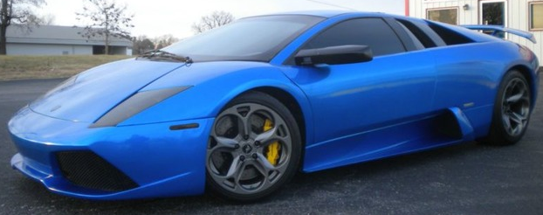
C, C++, Rust – A Comparison
C, vintage 1971
C++, vintage 1979
Rust, vintage 2006
Image Sources: Speed Hunters, Beverly Hills Car Club, Free Classifieds
Notes:
Can you improve on a classic and bring along the old guard?

Slide 23
C/C++ versus Rust – Ecosystem Comparison
 | C/C++ | Rust
Build System | No standard – CMake, Visual Studio Project, Makefiles, … | Cargo
Dependency System | No standard – Use Build/Packaging System | Cargo
Packaging Format | No standard – Use Packaging System Format | Crate
Packaging System | No standard – Buckaroo, Conan, vcpkg, … | Cargo
Package Registry | No standard, all have < 1,000 packages: Use Packaging System’s | crates.io, > 34k packages
Reference Compiler | No standard – Microsoft/Windows – MSVC, Linux – GCC, Apple/Facebook/Google – Clang | Yes
Notes:
Note: For C/C++ there seem to be 3 distinct prominent communities:
Microsoft/Windows users who use Visual Studio or MSVC and primarily C++
UNIX/Linux users who use GCC and primarily C
Multi-platform users who primarily use C++ seem to gravitate towards Clang

Slide 24
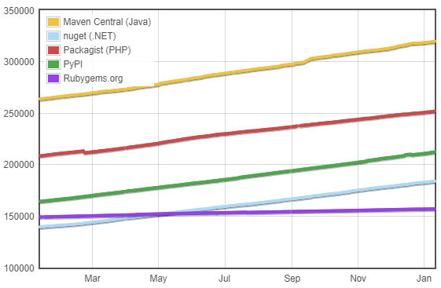

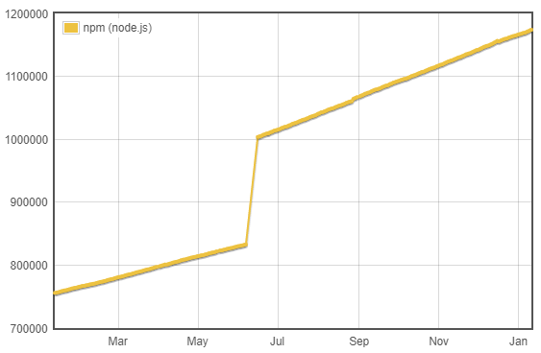
Programming Language Packaging System Comparison (Last Year)
The established mainstream languages have 100s of thousands of packages
JavaScript (Node) has > 1 million
Rust has solid growth
C/C++ don’t even have one sizeable package registry
Image Source: http://www.modulecounts.com/
Notes:
On an interesting note, Emacs (4420) and Vim (5536) both have more available packages through a package manager than C or C++!

Slide 25
C/C++ versus Rust – Language Comparison
 | C/C++ | Rust
Undefined Behavior | UB Everywhere, “… despite … excellent advances in tooling … UB-related problems are far from solved…”* | No UB in safe Rust
Strings | Poor Unicode support, weak typing, security problems, use of in-band terminator | Solid, but some complexity w/ String v. str
Arrays | Decay to pointer, don’t know size, weak dimensioning | Arrays don’t decay, know size, same dim issue though
Generics | Type enforcement complex using type traits, SFINAE, and other techniques on templates | Type enforcement easy through traits
Macros | Don’t understand C/C++ | Understand Rust, hygienic
Notes:
*Undefined Behavior in 2017, by John Regehr and Pascal Cuoq – compiler/static analysis experts

Slide 26
What is the Spectrum of Language Type Systems?
Language | Different Types | Variables Bound to Type | Function/Method Parameters Typed and Enforced | Type Enforcement | Implicit Conversions? | Type Safe? | Memory Safe?
Bash/Tcl¹ | No² | No | No | No | N/A | N/A | Yes
Python | Yes | No³ | Optional^{4,5} | Yes | Some | Yes | Yes
C | Yes | Yes | Optional/Weak⁶ | Weak⁶ | Yes (Unsafe) | Weak⁶ | No
C++ | Yes | Yes | Weak⁶ | Weak⁶ | Yes (Unsafe) | Weak⁶ | No
Rust | Yes | Yes⁷ | Yes | Yes⁸ | No | Yes⁸ | Yes⁸
ML/Haskell | Yes | Yes⁷ | Yes | Yes | No | Yes | Yes
Notes:
Type = roughly defined as assigning meaning to bits of computer memory, i.e., how to interpret them – integer, floating point, string?
Type System = set of rules for working with types; It attempts to limit errors by preventing operations that don't make sense
¹Assembly is an extreme with no types/typing whatsoever!
²In Bash/Tcl everything is a string
³Python objects have a type, but variable names are essentially just references to objects and have no type themselves
⁴Functions/Methods can enforce typing through Duck Typing or explicit checks
⁵Functions/Methods can enforce typing through static analysis with type annotations and tooling (e.g., mypy)
⁶C/C++ have a weak type system in the sense that they do:
unsafe implicit conversions/coercions
allow type punning (subversion) through void*
allow raw (unsafe) pointer access/dereferencing
ML/Haskell use a provably correct type system (formal verification)
⁷ML/Haskell provide static type inference so variable type annotations are typically not needed
Rust is like C++ combined with ML/Haskell – has a mostly proven type system and guarantees memory safety
⁷Rust provides static type inference so variable type annotations are typically not needed
⁸Rust has an unsafe mode which allows C-like access
See: https://en.wikipedia.org/wiki/Strong_and_weak_typing

Slide 27
Intro to Rust
Systems programming language
Includes high-level scripting like features
Designed for everyone
Inclusive, warm, and friendly community – beginners welcome
Ergonomics at the center of the language
Notes:
The C++ community in particular has gotten more including
It’s come a long way from the early days of UNIX where RTFM and you have the source code were typical answers to questions
However, Rust incorporates inclusivity at its very core
As a contrast the Linux Kernel and git communities can be somewhat harsh and expert-only friendly
Famously in 2018 Linus Torvalds apologized for his “unprofessional rants”
The Rust community seeks out everyone include beginners
When something isn’t clear the community tries to improve the documentation or the language
As a result Rust has excellent ergonomics
When you start using the compiler you will really appreciate this – especially if coming from C++

Slide 28
Rust – Hello World
Install Rust: Retrieve and run rustup-init from https://rustup.rs
For Windows, also need Build Tools for Visual Studio
Using cargo
cargo new hello
Use Visual Studio Code to inspect (has excellent plugin support for Rust)
cargo run from hello directory (looks for Cargo.toml)
Look at what cargo run created (Cargo.lock, target directory)
Documentation: rustup doc

Slide 29
Rust Variable Types – Numerics
Length | Signed | Unsigned | Floating-Point | Examples
8-bit | i8 | u8 |  | Decimal: 101_439
16-bit | i16 | u16 |  | Hex: 0xff
32-bit | i32 | u32 | f32 | Octal: 0o77
64-bit | i64 | u64 | f64 | Binary: 0b1111_0000
128-bit | i128 | u128 |  | Byte*: b’A’
Arch Native | isize (32 or 64) | usize (32 or 64) |  | *(u8 only)
Notes:
Note – in an interview on CppCast episode 200, ISO C++ Chairman Herb Sutter said it they had it to do over again, this is how they’d do it for C++ (for integers and floating points)
Examples:
32-bit Signed Integer: -2³¹…2³¹-1 (-2,147,483,648…2,147,483,647)
32-bit Unsigned Integer: 0…2³²-1 (0…4,294,967,295)
What Every Programmer Should Know About Floating-Point Arithmetic: https://floating-point-gui.de/

Slide 30
Rust Variable Types – Additional Scalars
Type | Keyword | Values | Notes
Boolean | bool | true | false
Character | char | ‘c’, ‘Ł’, ‘β’, ‘♬’, ‘€’, ‘∯’, ‘🏀’, ‘✔’, ‘😎’ | 4 bytes must use single quotes Unicode Scalar: U+0000 – U+D7FF, U+E000 – U+10FFF
Notes:
Unicode support means we can represent all the world’s languages and symbols including scientific and mathematical symbols, music, currency, check boxes, sports, emojis, and more.

Slide 31
Rust Variables – Compound Types
Type | Example | Notes
tuple | (1, ‘a’, true) | Size fixed at creation Supports any type
array | [1, 2, 3] | Size fixed at creation All elements must be same type
slice | &variable[#..#] | Non-owning (more later) Elements from variable in specified range
Notes:
Most scripting language have the concept of slices
You can use a range of values from an array or collection

Slide 32
Rust – Some Popular Collections from the Standard Library
Type | Keyword | Example | Notes
String | String | String::from(“Hello”) | UTF-8 encoding
String slice | str | “Goodbye” | Often borrowed: &str (more on this soon)
Vector | Vec<T> | vec![1, 2, 3] | Often use vec! macro to create
Hash Map | HashMap<K, V> | Coming…
Notes:
Note – many collections use generics to support a variety of types
T here represents a generic type
K, V represents a generic type for the key and a separate type for the value

Slide 33
Rust – Using Variables
// Typical:
let variable = value;
// Optionally specify type
let variable: type = value;
// Allow mutation:
let mut variable = value;
Notes:
Variables immutable by default to provide strong concurrency support
Shared mutable state is the root of all evil for concurrency
Variables can opt-in to being mutable with the mut keyword

Slide 34
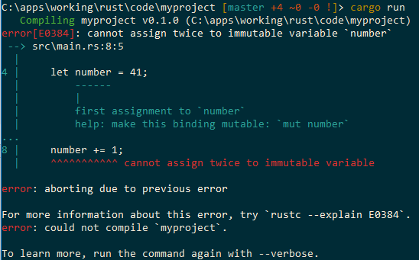
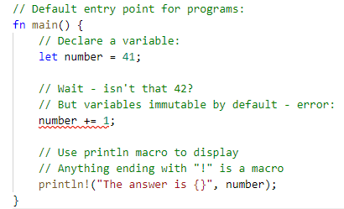
Rust – Using Variables
Immutable by default
Notes:
Variables immutable by default to provide strong concurrency support
Shared mutable state is the root of all evil for concurrency
Variables can opt-in to being mutable with the mut keyword

Slide 35
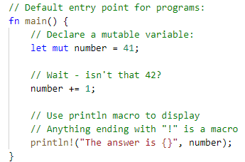
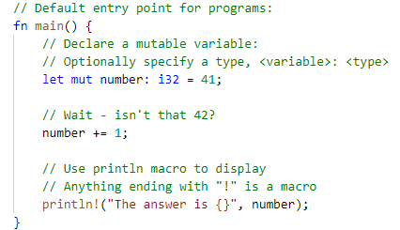
Rust – Using Variables
Mutability is opt-in
Type Inference – Thanks ML!
Can optionally specify
Notes:
Use mut keyword to make variable mutable
One thing I really like about Python is while I can specify types, it’s not required
That said, requiring types provides better safety, documentation, and facilitates refactoring
Rust derives from ML among other languages
This gives it type inference
Static typing without having to explicitly specify the type!
The benefits of strong typing without the hassle of specifying every type!
Can specify type if desired though

Slide 36
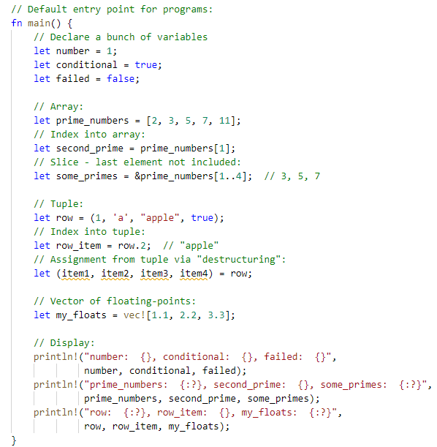
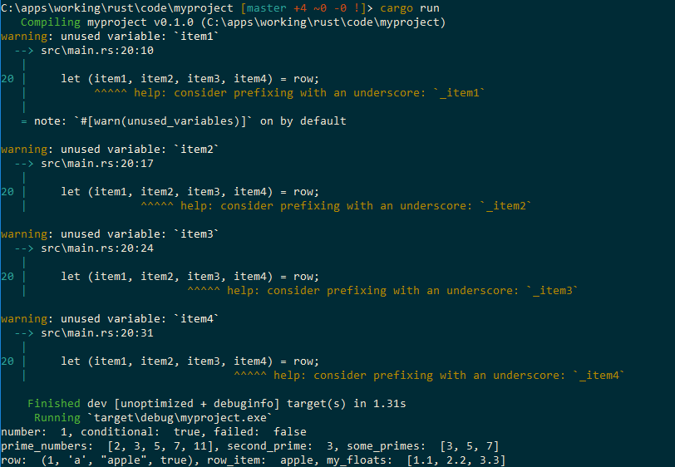
Rust – Using Variables
The compiler is strict
Complains about unused variables!
Notes:
Notice the orange squiggles in Visual Studio Code – these are unused variables

Slide 37
Rust – Using Functions
// Typical:
fn function1(param1: type, param2: type) -> return_type {
// body…
}
// Without parameters or return value:
fn function2() {
…
}

Slide 38
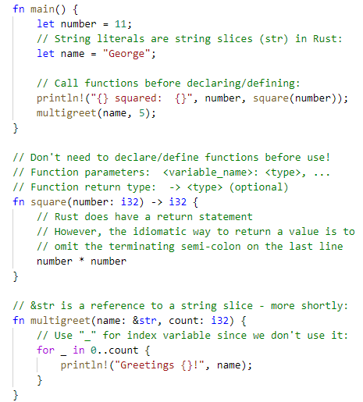
Rust – Using Functions
Many Rust keywords follow the UNIX naming convention – abridged and vowelless
function = fn (“fun”)
Unlike variable names, function parameters must have their type declared
Return type (if used) must also be declared
Unlike C/C++, functions don’t have to be declared/defined before use within the module (file)

Slide 39
Rust – Control Flow
// Don’t need parenthesis
// around condition:
if condition {
…
} else if condition {
…
} else {
…
}
// Loop forever
loop {
…
// Optional exit:
if condition {
break;
}
}
// Don’t need parenthesis:
while condition {
…
if condition {
// start over
continue;
} else {
// do stuff…
}
}

Slide 40
Rust – Control Flow
// Iterate over collection
for item in collection {
…
}
// if-else/switch/case improved:
match variable {
// Specific cases:
value1 => // do stuff,
value2 => // do stuff,
// Optional wildcard case:
_ => // do stuff
}

Slide 41
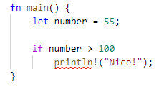
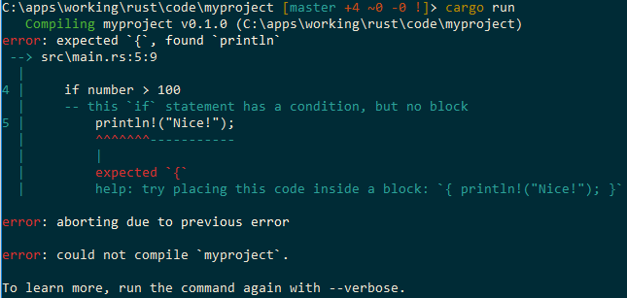
Rust – Control Flow
Note – unlike C/C++, can’t omit {}:
The source of many errors…
Probably for the best.

Slide 42
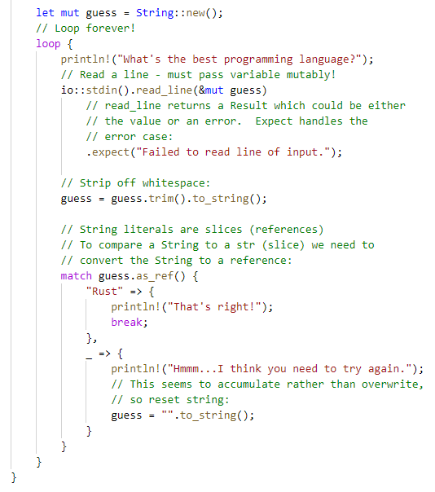
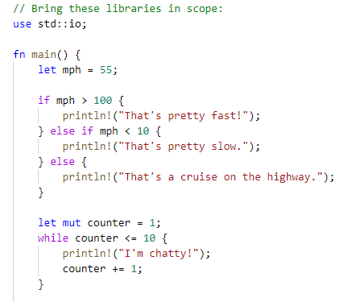
Rust – Control Flow
Examples:

Slide 43
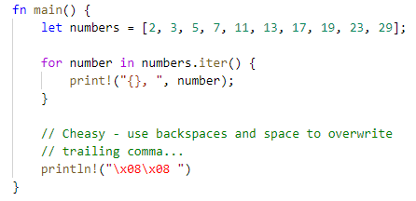
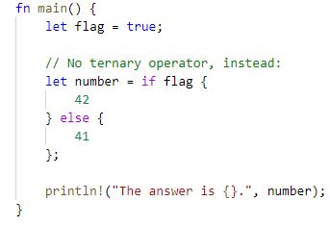
Rust – Control Flow
More Examples:
For loop with iterators
No ternary expression
Conditionally assign like this:

Slide 44
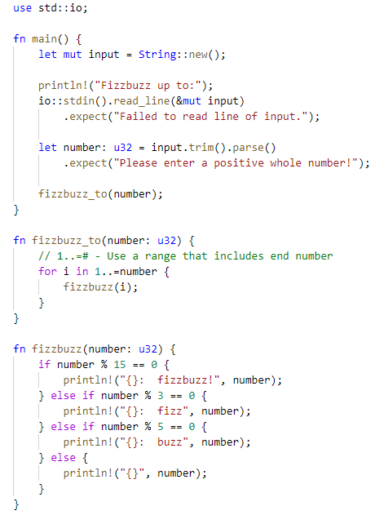
Rust – Fizzbuzz
Are you ready for an interview in Rust?
Image Source: x

Slide 45
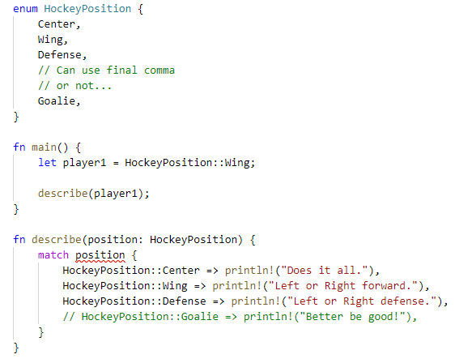
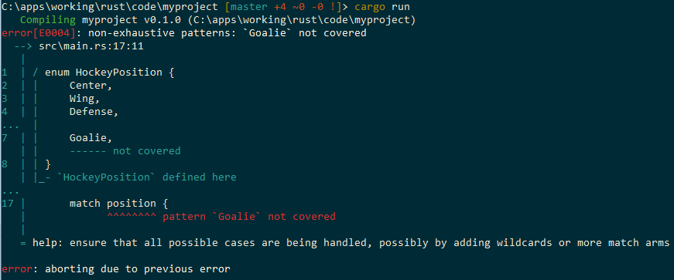
Rust – Enumerations
A collection where one element can be valid
Matches on enums must be exhaustive (cover all cases)!

Slide 46
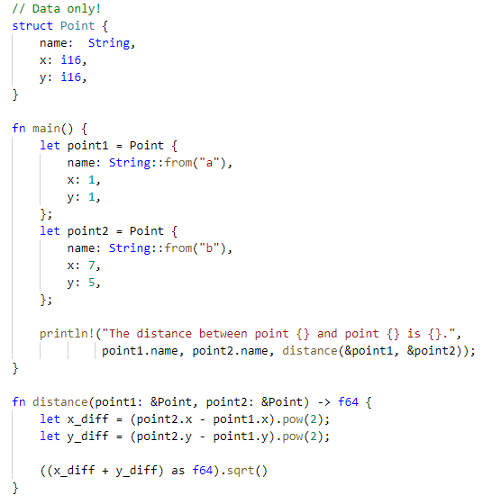
Rust – Structs
General User-Defined Type
Image Source: x

Slide 47
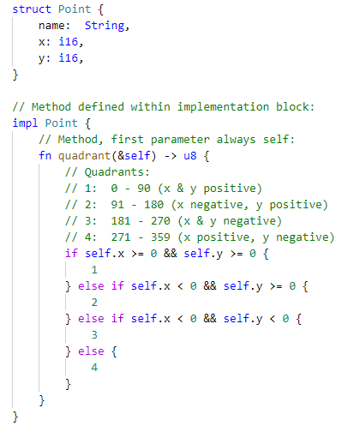
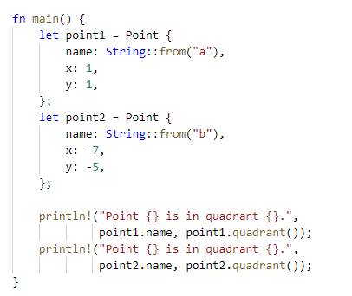
Rust – Methods

Slide 48

Rust – Memory Management and Ownership
Systems programming languages
No GC
Traditionally = manual memory management
And…not memory safe
Other programming languages
Use GC
Automatic memory management
But non-deterministic performance when GC runs…
Image Source: Ivan Kuznetsov

Slide 49
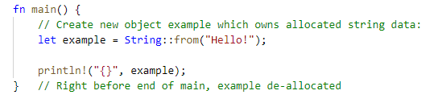
Rust – Memory Management and Ownership
Rust is a systems programming language
But automatic memory management
Provides memory safety
Implemented through ownership
Image Source: x
Notes:
Uses similar model as C++ RAII
Memory allocated when object created
Variable owns data
Memory deallocated when object goes out of scope
Access to variable after deallocation not allowed – compiler error

Slide 50

How Does Memory Safety Relate to Undefined Behavior (UB)?
One result of compromising memory integrity
What is UB? From the C FAQ:
Anything at all can happen; the Standard imposes no requirements. The program may fail to compile, or it may execute incorrectly (either crashing or silently generating incorrect results), or it may fortuitously do exactly what the programmer intended.
In Internet parlance, “When the compiler encounters [a given undefined construct] it is legal for it to make demons fly out of your nose.”
The current C Standard defines about 200 conditions which lead to UB!
Image Source: Wikipedia
Notes:
Even more fun – UB allows aggressive compiler optimizations so a so-called working program can break at any time when re-compiled as the compiler may implement new optimizations.
Understanding Integer Overflow in C/C++: https://www.cs.utah.edu/~regehr/papers/overflow12.pdf
http://catb.org/jargon/html/N/nasal-demons.html
Current C17 Standard has over 10 pages of small print describing conditions which result in Undefined Behavior and 58 references to UB!
Current C++17 standard has 75 references to UB!
Unfortunately there isn’t an explicit list of conditions like for C

Slide 51
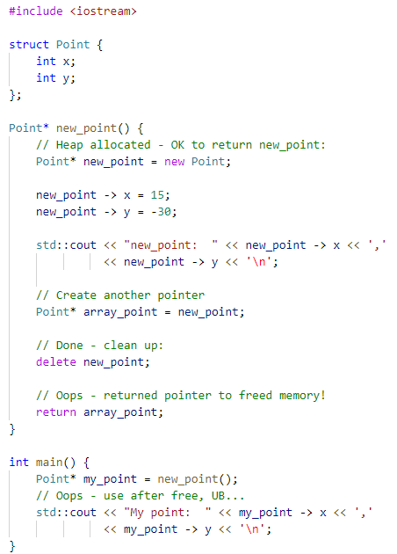
UB Example – Use After Free 1 (C++)
Windows 10 (MSVC) – varies:
Sometimes Access Violation
Sometimes appears to run fine:
new_point: 15,-30
My point: 15,-30
Ubuntu 18 (GCC) – different values, no crash:
new_point: 15,-30
My point: 0,0

Slide 52
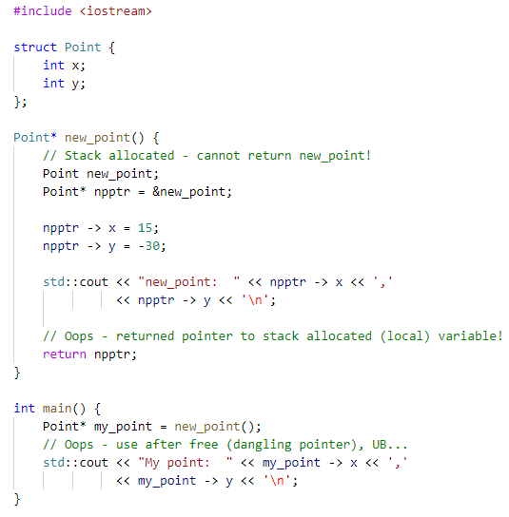
UB Example – Use After Free 2 (C++)
Windows 10 (MSVC) – works:
new_point: 15,-30
My point: 15,-30
Ubuntu 18 (GCC) – different values, no crash:
Values change each run:
new_point: 15,-30
My point: 15,32764

Slide 53
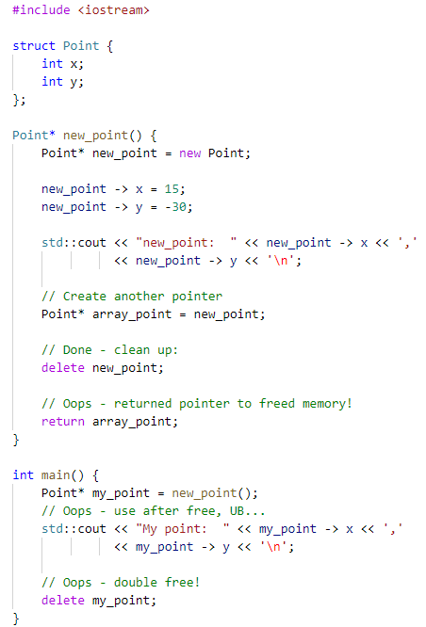
UB Example – Double Free (C++)
Windows 10 (MSVC) – heap corruption:
Values change each run:
new_point: 15,-30
My point: 19609608,19529920
Ubuntu 18 (GCC) – different values, no crash:
new_point: 15,-30
My point: 0,0

Slide 54
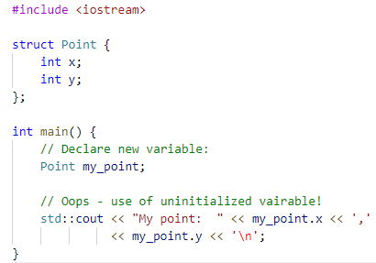
UB Example – Uninitialized Variable Usage (C++)
Windows 10 (MSVC) – works:
Values change each run:
My point: 20093154,6193152
Ubuntu 18 (GCC) – different values, no crash:
My point: 0,0

Slide 55
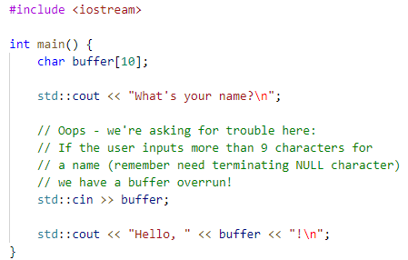
UB Example – Buffer Overflow (C++)
Windows 10 (MSVC) – stack buffer overrun:
What's your name?
George_Longer_Than_Your_Buffer!
Hello, George_Longer_Than_Your_Buffer!!
Ubuntu 18 (GCC) – crash:
What's your name?
George_Longer_Than_Your_Buffer!
Hello, George_Longer_Than_Your_Buffer!!
*** stack smashing detected ***: <unknown> terminated
Aborted (core dumped)

Slide 56
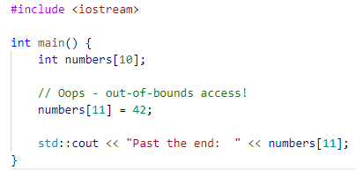
UB Example – Out-of-Bounds Access (C++)
Windows 10 (MSVC) – works:
Past the end: 42
Ubuntu 18 (GCC) – crash:
*** stack smashing detected ***: <unknown> terminated
Aborted (core dumped)

Slide 57
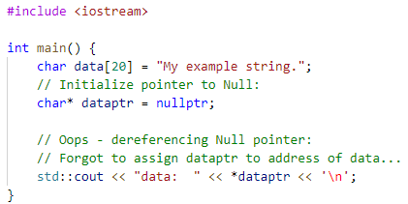
UB Example – Null Pointer Access (C++)
Windows 10 (MSVC) – crash:
No output…
Ubuntu 18 (GCC) – crash:
Segmentation fault (core dumped)

Slide 58
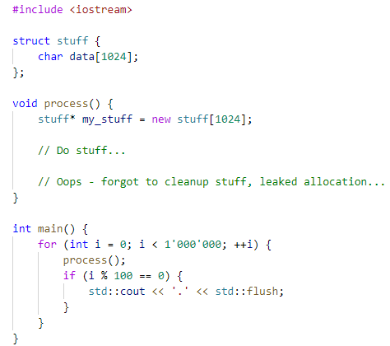
UB Example – Memory Leak (C++)
Windows 10 (MSVC) – stack buffer overrun:
...................
Ubuntu 18 (GCC)* – crash:
.........................................terminate called after throwing an instance of 'std::bad_alloc'
what(): std::bad_alloc
Aborted (core dumped)
Notes:
*Had to pass –m32 flag to create 32 bit binary, otherwise doesn’t crash! (Default is 64 bit binary with insanely large address space…)

Slide 59
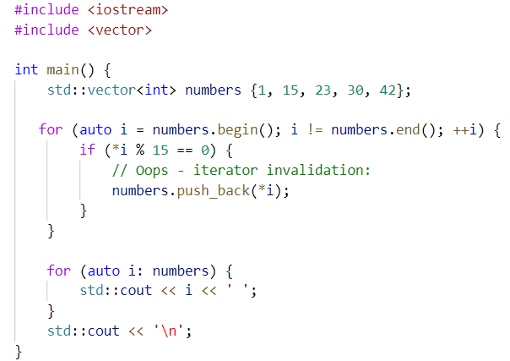
UB Example – Iterator Invalidation (C++)
Windows 10 (MSVC) – access violation:
No output
Ubuntu 18 (GCC) – crash:
Segmentation fault (core dumped)

Slide 60
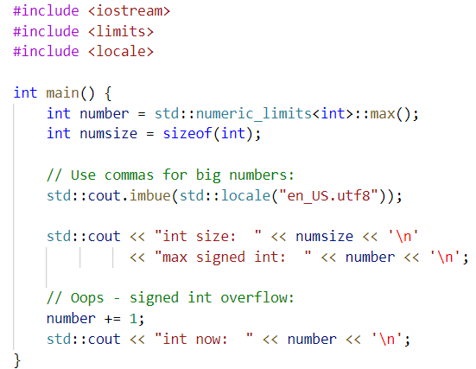
UB Example – Signed Integer Overflow (C++)
Windows 10 (MSVC) – works:
int size: 4
max signed int: 2,147,483,647
int now: -2,147,483,648
Ubuntu 18 (GCC) – same…

Slide 61
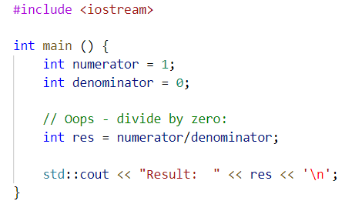
UB Example – Divide by Zero (C++)
Windows 10 (MSVC) – divide by zero exception:
No output
Ubuntu 18 (GCC) – crash:
Floating point exception (core dumped)

Slide 62
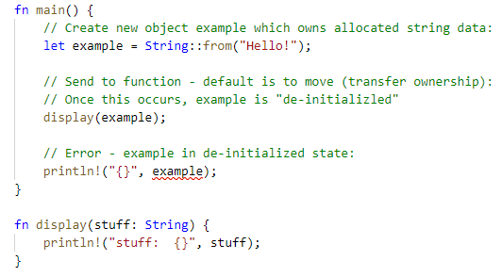
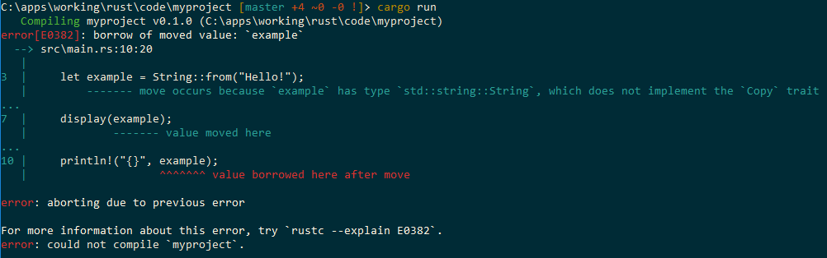
Rust – Borrowing and the Borrow Checker
Default behavior is to move values

Slide 63
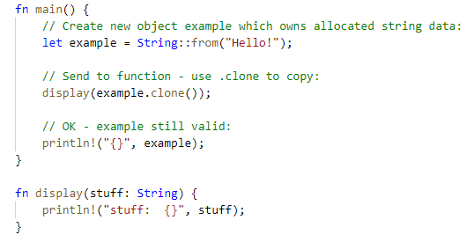
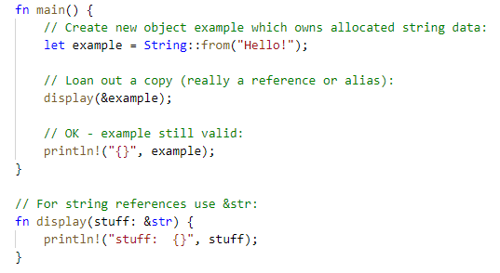
Rust – Borrowing and the Borrow Checker
Can also copy object:
Or loan out a reference to it:

Slide 64
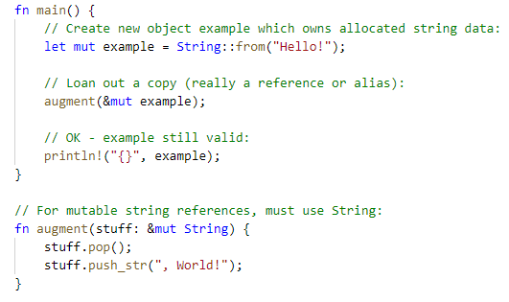
Rust – Borrowing and the Borrow Checker
Mutating object:

Slide 65
Rust – Borrowing and the Borrow Checker
Type | Ownership | Alias? | Mutate? | Owner Access
T | Owned | N/A | ✔ | Full
&T | Shared reference | ✔ | ❌ | Read-only
&mut T | Mutable reference | ✔ | ✔ | None
Notes:
In a modern concurrent language, shared mutable state is ticking time bomb
Rust’s compiler enforces a reader-writer lock model
The owner has full access
If the owner loans out one or more read-only references, his access becomes read-only until all references are destroyed
While any read-only references exist, it’s not possible to mutate the variable
If the owner loans out a mutable reference then no other references can be given and the mutable reference has exclusive access
Even the owner will be blocked from accessing the object while the mutable reference exists

Slide 66
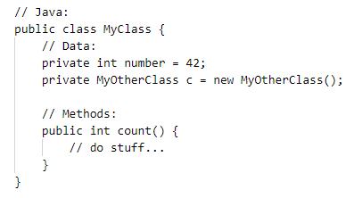
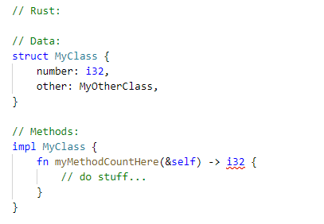
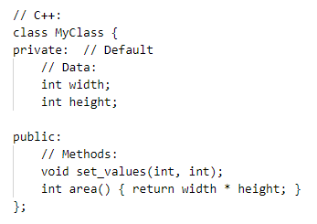
Rust – Compared to other Languages, Classes

Slide 67
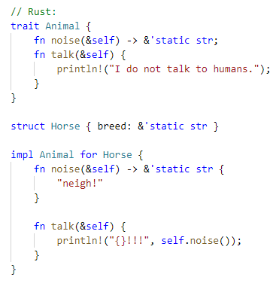
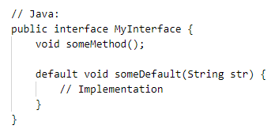
Rust – Compared to other Languages, Interfaces

Slide 68
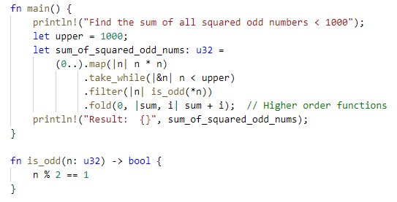
Rust – Functional Example

Slide 69
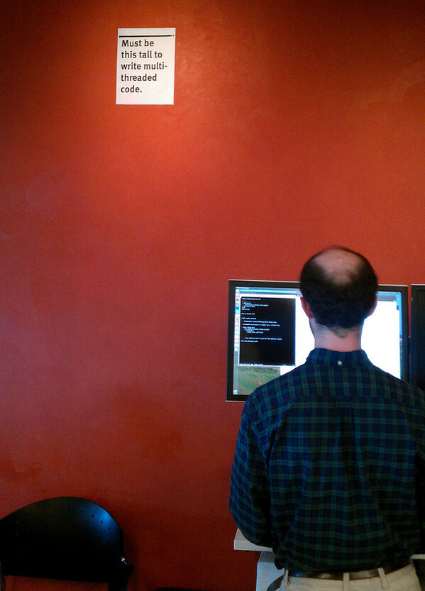
Thoughts on concurrent programming in C/C++
Mozilla has a developer hierarchy from junior to senior
In addition, four engineers have achieved the highest level – distinguished engineer
One of them, David Baron, has a sign by his desk about concurrent programming
Firefox’s CSS rendering engine is an example of an “embarrassingly parallel” opportunity
Firefox is written in C++
The team found it too difficult to develop a highly concurrent secure and maintainable solution in C++
Image Source: https://bholley.net/blog/2015/must-be-this-tall-to-write-multi-threaded-code.html
Notes:
David Baron, who works out of Mozilla's San Francisco Office, has a sign next to his cubicle
Although David is tall at well over six feet, the sign towers over him
The sign reads, "Must be this tall to write multi-threaded code.“

Slide 70

UB Ex – Data Race (C++)
Windows 10 (MSVC) – works:
Results vary (e.g.):
Insufficient funds!
account1.balance: 60
account2.balance: 140
Ubuntu 18 (GCC) – works:
Results vary (e.g.):
account1.balance: 185
account2.balance: 15

Slide 71

CPU Trends
CPU Speeds flat since 2005
Single-threaded (non-concurrent) performance gains near flat
Efficient/ Concurrent/ Parallel/ Distributed programming key
Image Source: https://www.karlrupp.net/2018/02/42-years-of-microprocessor-trend-data/
Notes:
For a long time, the theory was don’t worry about performance – Moore’s law will save you
However, many think Moore’s law is in trouble
Virtually all performance gains for the past 15 years have come from concurrency

Slide 72

One Measure of Performance
TechEmpower Web Framework Benchmarks, Round 18 (July 9, 2019)
Rust has top 2 slots
Next closest is C at 65% of speed, Go at 62.1% of speed
Then Java at 57.4% and C++ at 51.3%
Image Source: https://www.techempower.com/benchmarks/

Slide 73

Rust – Concurrent Example

Slide 74
Intro to Rust – Using Cargo
> cargo search bingrep
bingrep = "0.8.1" # Cross-platform binary parser and colorizer
goblin = "0.1.3" # An impish, cross-platform, ELF, Mach-o, and PE binary parsing and loading crate
> cargo install bingrep
Updating crates.io index
Downloaded bingrep v0.8.1
Downloaded 1 crate (617.2 KB) in 1.19s
Installing bingrep v0.8.1
Downloaded cpp_demangle v0.2.14
Downloaded prettytable-rs v0.8.0
(…)
Compiling proc-macro2 v1.0.7
Compiling unicode-xid v0.2.0
(…)
Compiling bingrep v0.8.1
Finished release [optimized] target(s) in 2m 28s
Installing C:\Users\js646y\.cargo\bin\bingrep.exe
Installed package `bingrep v0.8.1` (executable `bingrep.exe`)
> bingrep …

Slide 75
Rust – Additional Topics
Error Handling
Basics with panicking
Basics with Optional and Result
Lifetimes
Object Oriented Features
Can’t inherit from structs but can specialize methods
Traits
Philosophy of separating data and behavior

Slide 76

Questions
Image Source: Machine Design

Slide 77
References
Coming…

